Slide 1
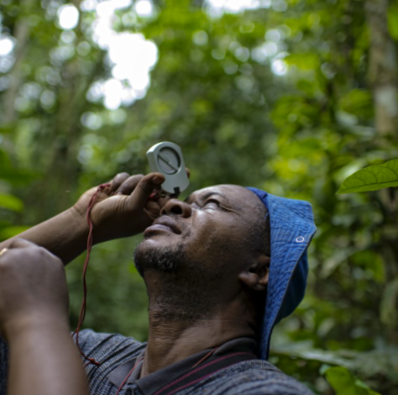
Agriculture methodology
PART I: INTRODUCTION, OBJECTIVES, OVERVIEW OF AGRICULTURE POLICIES AND KEY STEPS
Date
Presenter’s name

Slide 2










Series of ICAT Assessment Guides
Introductory Guide
Impact Assessment Guides
Process Guides
Greenhouse gas impacts
Renewable
Energy
Transport
Pricing
Agriculture
Building
Efficiency
Forestry
Stakeholder Participation
Cross-cutting
Technical Review
Sustainable Development
Transformational Change
Non-State and Subnational Action
Notes:
PRESENTATION TEXT: The series of ICAT guidance is intended to enable users that choose to assess GHG impacts, sustainable development impacts and transformational impacts of a policy to do so in an integrated and consistent way within a single impact assessment process. Refer to the ICAT Introductory Guide for more information about the ICAT guidance documents and how to apply them in combination.

Slide 3
Overview of the Agriculture Methodology
Part 1
Introduction, objectives, key steps and overview of agriculture policies and key steps
Understand purpose and applicability of the guidance (Chapter 1)
Determine the objectives of the assessment (Chapter 2)
Understand agriculture policies (Chapter 3)
Understand steps and assessment principles (Chapter 4)
Part 2
Defining the assessment
Clearly describe the policy to be assessed (Chapter 5)
Identify the GHG impacts to assess (Chapter 6)
Part 3
Assessing impacts
Estimate the baseline scenario and emissions (Chapter 7)
Estimate the implementation potential of the policy and quantify the emissions ex-ante (Chapter 8)
Estimate the impact of the policy ex-post (Chapter 9)
Part 4
Monitoring and reporting
Monitor the performance of the policy over time (Chapter 10)
Report the results and methodology used (Chapter 11)
Notes:
PRESENTATION TEXT: These are the various steps outlined in the Guidance document. This presentation covers part I.

Slide 4

Part I: Steps overview
This is an interactive panel: navigate by clicking on a particular step
Introduction, objectives, key steps and overview of agriculture policies and key steps
Part 1
Understand purpose and applicability of the guidance (Chapter 1)
Determine the objectives of the assessment (Chapter 2)
Understand agriculture policies (Chapter 3)
Understand steps and assessment principles (Chapter 4)
This button indicates a key recommendation
Notes:
[SLIDE FUNCTIONALITY NOTES: In the interactive panel, there are button to lead the presenter to different chapters or back to a previous slide. In addition, it also highlights specific guides (and provides links) that are related to the content discussed and provide further information on the topic. Click on the relevant chapters to go directly to them.]

Slide 5
Chapter 1. Understand purpose and applicability of the guidance
Chapter 1
Purpose of the guidance
Intended users
Scope and applicability
When to use the guidance
Notes:
PRESENTATION TEXT: With the adoption of the Paris Agreement in 2015, governments around the world are increasingly focused on implementing policies and actions that achieve greenhouse gas (GHG) mitigation objectives. The agriculture, forestry and other land use (AFOLU) sector contributes to approximately one quarter of anthropogenic GHG emissions. In the agriculture sector, emissions are mainly from soil, livestock and nutrient management. Cost effective mitigation options in agriculture are cropland management, grazing land management and restoration of organic soils. There is an increasing need to assess and communicate the impacts of agriculture policies to ensure they are effective in delivering GHG mitigation and helping countries meet their sectoral targets and commitments.
[SLIDE FUNCTIONALITY NOTES: Click on the blue boxes to go directly to the relevant sections.]

Slide 6

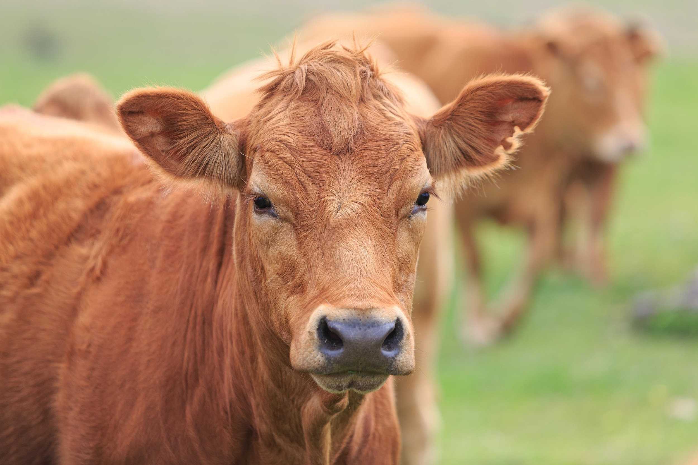


Purpose of the guidance
Helps users assess the GHG impacts of agriculture policies
Helps decision makers develop effective policies that enable mitigation practices or technologies that reduce enteric fermentation emissions
Helps decision makers develop effective policies that enable enhanced soil carbon sequestration activities in agriculture
Supports consistent and transparent reporting of emission impacts and policy effectiveness
Chapter 1
Chapter 2
Chapter 3
Chapter 4
Notes:
PRESENTATION TEXT: This document provides methodological guidance for assessing the GHG impacts of agriculture policies that enable or incentivise mitigation practices or technologies that reduce emissions from enteric fermentation and increase soil carbon sequestration in pasture, grazing lands and croplands.
It is intended to be used in combination with any other ICAT guidance documents that users choose to apply.

Slide 7





Wide range of intended users
Governments
Donor agencies and financial institutions
Stakeholders affected by policies and actions
Research institutions
and NGOs
Businesses
Chapter 1
Chapter 2
Chapter 3
Chapter 4
Notes:
PRESENTER TEXT:
Governments: Assess the expected impacts of policies or actions to inform the design of transformational policies, and monitor progress and evaluate impacts of implemented policies or actions to learn from experience.
Stakeholders affected by policies and actions, such as local communities and civil society organisations: Participate more effectively in and influence the design, implementation and assessment of policies and actions to ensure their concerns and interests are addressed.
Donor agencies and financial institutions: Assess the impacts of financial support provided, such as grants or loans, to support transformational policies or actions.
Businesses: Assess impacts of private sector actions such as voluntary commitments and implementation of new technologies, private sector financing, or the impacts of government policies or actions on businesses and the economy.
Research institutions and NGOs: Assess the extent to which policies or actions are transformational to generate new information to increase stakeholder awareness and support decision makers.

Slide 8
Scope of the guidance
Overarching framework for estimating GHG impacts of policies that mitigate GHG emissions from:
  Enteric fermentation
  Soil carbon pool
Includes procedures for:
  Defining the assessment
  Conducting a GHG assessment including both forward-looking (ex-ante) and backward-looking (ex-post) assessments
  Transparent reporting to ensure proper interpretation of the results
Provides a flexible and non-prescriptive approach to accommodate various national circumstances
Provides key recommendations to produce high-quality impact assessments
Chapter 1
Chapter 2
Chapter 3
Chapter 4
Notes:
PRESENTATION TEXT: This guidance provides general principles, concepts and procedures for estimating GHG impacts of agricultural policies that mitigate GHG emissions from enteric fermentation and soil carbon sequestration. It details a process for users to follow when conducting GHG assessment of agriculture policies.

Slide 9
Applicability of the guidance
Applies to policies:
  At any level of government in all countries and regions.
  That are planned, adopted or implemented.
  That are new policies, or extensions, modifications or eliminations of existing policies
Introductory Guide
Chapter 1
Chapter 2
Chapter 3
Chapter 4
Notes:
PRESENTATION TEXT: The guidance is applicable to users that have defined the individual policy instruments and mitigation practices and/or technologies that could be implemented to reduce GHG emissions. More details about the intended users, the types of policies and actions, and when to use the methodology is found in the Introductory Guide.
[SLIDE FUNCTIONALITY NOTES: Click on the green Introductory Guide button at the bottom to go directly to the web page where the ICAT Introductory Guide can be found.]

Slide 10
When to use the guidance
Guidance can be applied at any of the stages below or a combination
Define the policy
Assess before policy implementation |  | To assess the expected future impacts of a policy through ex-ante assessment
Implement the policy
Assess during policy implementation | To assess the achieved impacts to date | To assess ongoing performance of key performance indicators | To assess expected future impacts of a policy
Monitor progress
Assess after policy implementation |  | To assess what impacts have occurred as a result of a policy through ex-post assessment
Chapter 1
Chapter 2
Chapter 3
Chapter 4
Notes:
PRESENTATION TEXT: The guidance can be applied before, during or after the policy implementation. The most comprehensive approach is to apply the guidance first before implementation, regularly during policy implementation, and again after implementation.

Slide 11
Chapter 2. Determine the objectives of the assessment
Understand the objectives of estimating GHG impacts
Objectives of assessing impacts before policy implementation
Objectives of assessing impacts during or after policy implementation
Notes:
[SLIDE FUNCTIONALITY NOTES: Click on the blue boxes to go directly to the relevant sections.]

Slide 12

Objectives of assessing GHG impacts
Objectives of assessing impacts before (ex-ante) policy implementation:
Inform policy selection by comparing policy options based on their expected future impacts
Improve policy design and implementation by understanding the impacts of different design and implementation choices
Inform goal setting by assessing the potential contribution of policy options to national goals, such as NDCs and NAMAs
Report on the multiple expected future impacts of policies, domestically and/or internationally
Access financing for policies under consideration by demonstrating expected future results
Users should identify intended audience of the assessment report and can refer to the Stakeholder Participation Guidance.
Determine the objectives of the assessment at the beginning of the impact assessment progress.
Chapter 1
Chapter 2
Chapter 3
Chapter 4
Notes:
PRESENTATION TEXT: Users should identify intended audience of the assessment report. Possible audience can include policy makers, general public, NGOs, companies, funders, and research institutions. The ICAT Stakeholder Participation Guidance can provide more information on identifying stakeholder.
[SLIDE FUNCTIONALITY NOTES: Click on the blue Stakeholder Participation button at the bottom to go directly to the web page where the ICAT Assessment Guide for Stakeholder Participation can be found.]

Slide 13
Objectives of assessing GHG impacts
Objectives of assessing impacts during or after (ex-post) policy implementation:
Assess policy effectiveness
Improve policy implementation
Inform future policy design and decide whether to continue current actions, enhance current actions or implement new actions
Learn from experience and share best practices
Track progress toward national goals (e.g. NDCs and SDGs) and understand the contribution of policies toward achieving them
Report domestically or internationally on the impacts of policies achieved to date
Meet funder requirements to report on impacts of policies
Determine the objectives of the assessment at the beginning of the impact assessment progress.
Chapter 1
Chapter 2
Chapter 3
Chapter 4
Notes:
PRESENTATION TEXT: Again the audience for the assessment should be determined and the ICAT Stakeholder Participation Guidance can provide more information on identifying stakeholder.
[SLIDE FUNCTIONALITY NOTES: Click on the blue Stakeholder Participation button at the bottom to go directly to the web page where the ICAT Assessment Guide for Stakeholder Participation can be found.]

Slide 14
Chapter 3. Understand agriculture policies
Overview of the types of agriculture policies, and mitigation practices and technologies, to which this guidance can be applied.
Agriculture policy instrument
(Section 3.1)
Mitigation practices or technologies
(Section 3.2)
Notes:
[SLIDE FUNCTIONALITY NOTES: Click on the blue boxes to go directly to the relevant sections.]

Slide 15







3.1 Agriculture policy instruments
Example
Example
Example
Example
Regulations and standards
Subsidies and incentives
Voluntary agreements or actions
Information instruments
Example
Example
Example
Trading programmes
Research, development and deployment policies
Financing and investment
Chapter 1
Chapter 2
Chapter 3
Chapter 4
Notes:
PRESENTATION TEXT:
Regulations and standards: Rules or standards that specify abatement technologies (technology standard) or performance standards (such as minimum requirements for erosion rates, tillage setbacks or nutrient management. They typically include legal penalties for noncompliance.
Subsidies and incentives: Direct payments, tax reductions, price supports or the equivalent thereof from a government to an entity for implementing a practice or performing a specified action.
Voluntary agreements or actions: Agreements, commitments or actions undertaken voluntarily by public or private sector actors, either unilaterally or jointly in a negotiated agreement. Some voluntary agreements include rewards or penalties associated with participating in the agreement or achieving the commitments.
Information instructions: Requirements for public disclosure of information. These include labelling programmes, emissions reporting programmes, rating and certification systems, benchmarking, and information or education campaigns aimed at changing behaviour by increasing awareness.
Trading programmes: Programmes that establish a limit on aggregate emissions or pollutants from specified sources, requires sources to hold permits, allowances, or other units equal to their actual emissions or pollution, and allows permits to be traded among sources.
Research, development and deployment policies: Policies aimed at supporting technological advancement, through direct government funding or investment, or facilitation of investment, in technology research, development, demonstration, and deployment activities.
Financing and investment: Public or private sector grants or loans (for example, those supporting low-carbon development strategies or policies).
[SLIDE FUNCTIONALITY NOTES: Click on the blue Example arrows to go directly to the examples. The presenter can add their own country specific examples to make the presentation more relevant for that country.]

Slide 16
3.2 Common mitigation practices or technologies
Practices to reduce enteric fermentation emissions | Practices to reduce emissions and enhance removals from the soil carbon pool
Livestock feeding strategies Improve herd management strategies Optimising health and reproductive capacity Improve pasture management Improve silvopastoral systems Improve efficiency in production systems | Switch to no-till or conservation tillage agriculture Improve agricultural residue management Increase soil stability and reduce erosion Increase vegetation cover and biomass Improve agroforestry and/or silvopastoral systems Institute rotational grazing practices Change pasture species selection Increase sustainable agriculture intensification Establish conservation or restoration of natural systems Rewetting of wetland mineral or organic soils previously drained for crop production or grazing
Chapter 1
Chapter 2
Chapter 3
Chapter 4

Slide 17
Chapter 4. Understand steps and assessment principles
Overview of the underlying concepts, methodological steps and planning needed for assessing the impacts of agriculture policies.
Overview of steps
(Section 4.1)
Planning for the assessment
(Section 4.2)
Assessment principles
(Section 4.3)
Notes:
[SLIDE FUNCTIONALITY NOTES: Click on the blue boxes to go directly to the relevant sections.]

Slide 18
4.1 Overview of the steps
The guidance is organised according to the steps a user follows in assessing the GHG impacts of a policy
Depending on when the guidance is applied and the approach chosen, users can skip certain chapters.
Overview of steps
Chapter 1
Chapter 2
Chapter 3
Chapter 4
Notes:
PRESENTATION TEXT: The overview steps are those which were seen in slide 3.
[SLIDE FUNCTIONALITY NOTE: Click on the “Overview of steps” button to review the steps.]

Slide 19


4.2 Planning for the assessment
Choose a desired level of accuracy
(Section 4.2.1)
Select approaches for assessing the GHG impacts of agriculture policies (Section 4.2.2)
Select a methodology for obtaining or estimating data
(Section 4.2.3)
Expert judgement
(Section 4.2.4)
Plan for stakeholder participation
(Section 4.2.5)
Plan for technical review (if relevant)
(Section 4.2.6)
Chapter 1
Chapter 2
Chapter 3
Chapter 4
Notes:
[SLIDE FUNCTIONALITY NOTES: Click on the light blue boxes to go directly to the relevant sections. Click on the blue Stakeholder Participation button or the blue Technical Review button to go directly to the web page where the ICAT Assessment Guides are found.]

Slide 20
4.2.1 Choosing a desired level of accuracy
The objectives of the assessment will determine the level of accuracy required
Broad objectives
(e.g., to assess if a policy contributes to reduced GHG impacts)
Specific objectives
(e.g., a particular reduction occurs due to a specific policy)
LOW
HIGH
ACCURACY
The accuracy will determine the amount of data, time and resources required for the assessment
Data
Time
Resources
User need to manage trade-offs between the accuracy of the results and the data, time and resources required
Chapter 1
Chapter 2
Chapter 3
Chapter 4
Notes:
PRESENTATION TEXT: There are a range of options for assessing GHG impacts that allow users to manage trade-offs between the accuracy of the results and the resources, time, and data needed to complete the assessment, based on objectives.
Users should choose approaches and methods that are sufficient to accurately meet the stated objectives of the assessment and ensure that the resulting claims are appropriate.

Slide 21


4.2 Planning for the assessment
EMISSIONS APPROACH
ACTIVITY DATA APPROACH
Compares the difference in GHG emissions and removals between the policy and baseline scenarios
Difference between policy and baseline scenario is the impact resulting from the policy
Focuses on estimating the effect of the policy on activity data by estimating the expected increase or decrease in the area of land or in the adoption of a mitigation practice that is triggered by the policy
Chapter 1
Chapter 2
Chapter 3
Chapter 4
Notes:
PRESENTATION TEXT:
Emissions approach: The difference between policy and baseline scenario emissions and removals is the net change in GHG impact resulting from the policy.
Activity data approach: The emissions associated with the increase or decrease in activity data are estimated to give the expected net change in GHG impact resulting from the policy.

Slide 22
4.2.2 Approaches for assessing the GHG impacts
Approach | Advantages | Disadvantages
Emissions approach | Enables more robust and accurate understanding of the GHG impacts of forest policies Meets wider set of objectives (related to understanding policy impact) Meets widest set of stakeholder needs | Increased time, cost, data and capacity needs, depending on approach taken (simpler to more complex)
Activity data approach | Gives an understanding of expected GHG impacts Easier, simpler, requires less time, resources and capacity | Provides a more informative estimate of the GHG impacts of the policy, which limits the range of objectives the assessment can meet Risk of over-simplification or limited understanding of relevant impact drivers
Chapter 1
Chapter 2
Chapter 3
Chapter 4

Slide 23
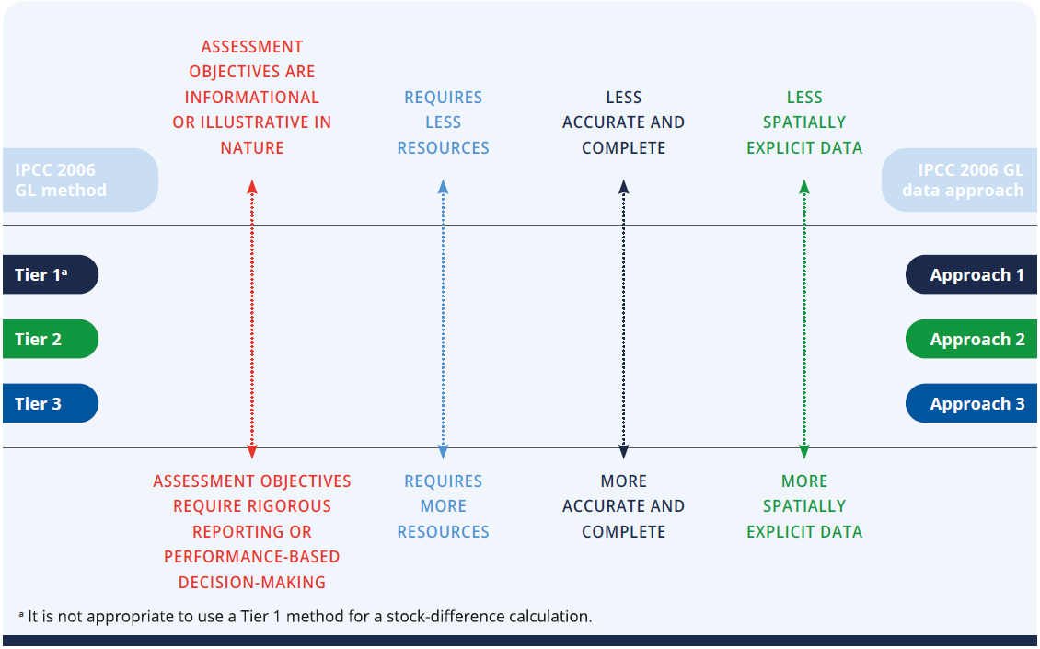
4.2.3 Methods for obtaining or estimating data
Guidance provides users the option to conduct the livestock GHG assessment using Tier 1 or Tier 2 emission factors; it does not describe higher Tier 3 methods.
ªTier 1 not sufficient to capture improvements in efficiency of livestock production
Chapter 1
Chapter 2
Chapter 3
Chapter 4
Notes:
PRESENTATION TEXT: The use of tiers is consistent with IPCC 2006 GL and so it would be helpful to become familiar with basic IPCC 2006 GL best practices and tables available therein. This guidance also sets out a method to estimate a preliminary Tier 2 emission factor for livestock.
Users may determine the assessment method based on both their assessment objectives and their capacity, resources and time available to carry out the assessment. For planning purposes, it is helpful for the user to identify the desired estimation method prior to beginning an impact assessment.

Slide 24

4.2.4 Expert judgement
Expert judgement is likely to be needed in order to complete an assessment where information is not available or requires interpretation.
IPCC 2006 GL provides procedures for expert elicitation which avoid biases and produce independent and reliable judgements.
Expert judgement can be informed through broader stakeholder consultation.
EXPERT JUDGEMENT (IPCC)
Carefully considered, well-documented qualitative or quantitative judgement made in the absence of unequivocal observational evidence by a person or persons who have a demonstrable expertise in the given field.
Chapter 1
Chapter 2
Chapter 3
Chapter 4
Notes:
[SLIDE FUNCTIONALITY NOTES: Click on the blue IPCC button at the bottom to go to the relevant webpage for the IPCC Guidelines. Click on the blue Stakeholder Participation button at the bottom to go directly to the web page where the ICAT Assessment Guide for Stakeholder Participation can be found.]

Slide 25
4.2.5 Planning stakeholder participation
Stakeholder participation is recommended in many steps throughout the guidance.
Strengthens the impact assessment and the contribution of policies to GHG mitigation goals in many way
Helps reduce negative impacts and enhance benefits for all stakeholder groups
Builds trust | Creates a mechanism for raising issues before implementation
Raises awareness | Enhances credibility
Enhances transparency | Enhances ambition and finance
Chapter 1
Chapter 2
Chapter 3
Chapter 4
Notes:
[SLIDE FUNCTIONALITY NOTES: Click on the blue Stakeholder Participation button at the bottom to go directly to the web page where the ICAT Assessment Guide for Stakeholder Participation can be found.]

Slide 26


4.2.6 Planning technical review
Before beginning the assessment process, consider whether technical review of the assessment report will be pursued.
The technical review process emphasises learning and continual improvement and can help identify areas for improving future impact assessments.
Technical review can also provide confidence that the impacts of policies have been estimated and reported according to ICAT key recommendations.
Chapter 1
Chapter 2
Chapter 3
Chapter 4
Notes:
PRESENTATION TEXT: Access the Technical Review Guide to obtain guidance for planning and conducting technical reviews.
[SLIDE FUNCTIONALITY NOTES: Click on the blue Technical Review button at the bottom to go directly to the web page where the ICAT Guide for Technical Review can be found.]

Slide 27
4.3 Assessment principles
Principles underpin and guide the impact assessment process
RELEVANCE
COMPLETENESS
CONSISTENCY
TRANSPARENCY
ACCURACY
Users should balance trade-offs between principles depending on their assessment objectives.
Over time, as the accuracy and completeness of data increases, the trade-off between these principles will likely diminish.
Base the assessment on the principles of relevance, completeness, consistency, transparency and accuracy.
Chapter 1
Chapter 2
Chapter 3
Chapter 4
Notes:
PRESENTATION TEXT:
Relevance: Ensure the assessment appropriately reflects the GHG impacts of the policy and serves the decision-making needs of users and stakeholders, both internal and external to the reporting entity. Applying the principle of relevance depends on the objectives of the assessment, broader policy objectives, national circumstances and stakeholder priorities.
Completeness: Include all significant impacts in the GHG assessment boundary, including both positive and negative impacts. Disclose and justify any specific exclusions.
Consistency: Use consistent assessment approaches, data collection methods and calculation methods to allow for meaningful performance tracking over time. Document any changes to the data sources, GHG assessment boundary, methods, or any other relevant factors in the time series.
Transparency: Provide clear and complete information for stakeholders to assess the credibility and reliability of the results. Disclose and document all relevant methods, data sources, calculations, assumptions and uncertainties. Disclose the processes, procedures and limitations of the assessment in a clear, factual, neutral, and understandable manner with clear documentation. The information should be sufficient to enable a party external to the assessment process to derive the same results if provided with the same source data. Chapter 11 provides a list of recommended information to report to ensure transparency.
Accuracy: Ensure that the estimated impacts are systematically neither over nor under actual values, as far as can be judged, and that uncertainties are reduced as far as practicable. Achieve sufficient accuracy to enable users and stakeholders to make appropriate and informed decisions with reasonable confidence as to the integrity of the reported information. If accurate data for a given impact category is not currently available, users should strive to improve accuracy over time as better data becomes available. Accuracy should be pursued as far as possible, but once uncertainty can no longer be practically reduced, conservative estimates should be used.

Slide 28
Part I: QUIZ 1
When is the Agricultural Guidance used?
Answers:
Before policy implementation
During policy implementation
After policy implementation
All of the above
Answer
Notes:
[SLIDE FUNCTIONALITY NOTE: Click on the “Answer” button to reveal the answer.]
[COUNTRY SPECIFIC SLIDE ADAPTATION NOTE: The quiz can be removed if preferred, or the questions could be altered or added to. Further, the quiz questions could be put into Mentimeter to make it more interactive for the audience]

Slide 29
Part I: QUIZ 2
The Agricultural Guidance provides an overarching framework for estimating GHG impacts of policies that mitigate against which emissions?
Answers:
Enteric fermentation and manure management
Enteric fermentation and direct N₂O from managed soils
Direct N₂O from managed soils and soil carbon sequestration
Soil carbon sequestration and enteric fermentation
Answer
Notes:
[SLIDE FUNCTIONALITY NOTE: Click on the “Answer” button to reveal the answer.]
[COUNTRY SPECIFIC SLIDE ADAPTATION NOTE: The quiz can be removed if preferred, or the questions could be altered or added to. Further, the quiz questions could be put into Mentimeter to make it more interactive for the audience]

Slide 30
Part I: QUIZ 3
What does ex-ante mean?
Answers:
Before policy implementation
During policy implementation
After policy implementation
All of the above
Answer
Notes:
[SLIDE FUNCTIONALITY NOTE: Click on the “Answer” button to reveal the answer.]
[COUNTRY SPECIFIC SLIDE ADAPTATION NOTE: The quiz can be removed if preferred, or the questions could be altered or added to. Further, the quiz questions could be put into Mentimeter to make it more interactive for the audience]

Slide 31
Part I: QUIZ 4
What is the approach for assessing GHG impacts called if the difference in GHG emissions and removals due to the policy are compared to the baseline scenarios?
Answers:
Activity data approach
Emissions approach
Tier 1 approach
Tier 2 approach
Answer
Notes:
[SLIDE FUNCTIONALITY NOTE: Click on the “Answer” button to reveal the answer.]
[COUNTRY SPECIFIC SLIDE ADAPTATION NOTE: The quiz can be removed if preferred, or the questions could be altered or added to. Further, the quiz questions could be put into Mentimeter to make it more interactive for the audience]

Slide 32
Part I: QUIZ 5
The Agriculture Guidance provides details on the use of which approaches for the livestock GHG assessment?
Answers:
Tier 1
Tier 2
Tier 3
Tier 1 and 2
Tier 1, 2 and 3
Answer
Notes:
[SLIDE FUNCTIONALITY NOTE: Click on the “Answer” button to reveal the answer.]
[COUNTRY SPECIFIC SLIDE ADAPTATION NOTE: The quiz can be removed if preferred, or the questions could be altered or added to. Further, the quiz questions could be put into Mentimeter to make it more interactive for the audience]

Slide 33
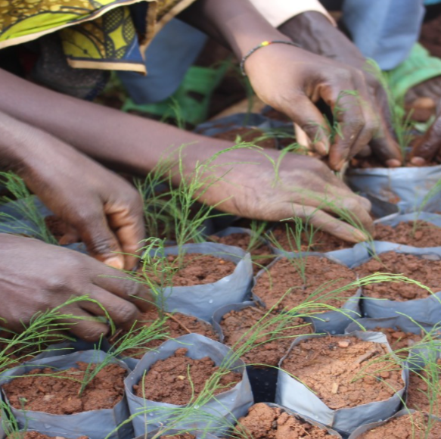
Thank you!
www.climateactiontransparency.org
icat@unops.org
Twitter: @ICATclimate
Notes:
[COUNTRY SPECIFIC SLIDE ADAPTATION NOTE: Add the presenters contact details and any other relevant contacts]

Slide 34

Checklist of key recommendations
Chapter | Key recommendation | Check
Chapter 2. Determine the objectives of the assessment | Determine the objectives of the assessment at the beginning of the impact assessment process.
Chapter 4. Understand steps and assessment principles | Base the assessment on the principles of relevance, completeness, consistency, transparency and accuracy.

Slide 35
3.1 Examples of agriculture policy instruments
Regulations and standards
Description:
Rules or standards that specify abatement technologies or performance standards. Typically include legal penalties for noncompliance
Examples:
Standards for management practices for livestock health and reproduction
Standards for implementing silvopastoral systems
Conservation mandates requiring landowners to place an area equivalent to 10% of cultivated lands into conservation reserve
Laws that promote connectivity between natural ecosystems
To agriculture policy list
Notes:
[COUNTRY SPECIFIC SLIDE ADAPTATION NOTE: Country specific examples can be added to the list by the presenter.]

Slide 36
3.1 Examples of agriculture policy instruments
Subsidies and incentives
Description:
Direct payments, tax reductions, price supports or the equivalent thereof from a government to an entity for implementing a practice or performing a specified action
Examples:
Tax reductions for setting aside agricultural land
Payments for changing agricultural practices
Payments for ecosystem services
To agriculture policy list
Notes:
[COUNTRY SPECIFIC SLIDE ADAPTATION NOTE: Country specific examples can be added to the list by the presenter.]

Slide 37
3.1 Examples of agriculture policy instruments
Voluntary agreements or actions
Description:
Agreements, commitments or actions undertaken voluntarily by public or private sector actors, either unilaterally or jointly in a negotiated agreement. Some voluntary agreements include rewards or penalties associated with participating in the agreement or achieving the commitment
Examples:
Zero net-deforestation commitments
Agroforestry agreements with landowners
National programmes to reduce emissions in a sector (e.g., NAMA)
Low carbon development projects
To agriculture policy list
Notes:
[COUNTRY SPECIFIC SLIDE ADAPTATION NOTE: Country specific examples can be added to the list by the presenter.]

Slide 38
3.1 Examples of agriculture policy instruments
Information instruments
Description:
Requirements for public disclosure of information.
Examples:
Programmes requiring standardised labelling on environmental attributes of agricultural products
Emissions reporting programmes
Rating and certification systems
Benchmarking
Information or education campaigns aimed at changing behaviour by increasing awareness
To agriculture policy list
Notes:
[COUNTRY SPECIFIC SLIDE ADAPTATION NOTE: Country specific examples can be added to the list by the presenter.]

Slide 39
3.1 Examples of agriculture policy instruments
Trading programmes
Description:
Programmes that establish a limit on aggregate emissions or pollutants from specified sources, requires sources to hold permits, allowances, or other units equal to their actual emissions or pollution, and allows permits to be traded among sources
Examples:
Nutrient trading programmes
Cap-and-trade programmes
To agriculture policy list
Notes:
[COUNTRY SPECIFIC SLIDE ADAPTATION NOTE: Country specific examples can be added to the list by the presenter.]

Slide 40
3.1 Examples of agriculture policy instruments
Research, development & deployment policies
Description:
Policies aimed at supporting technological advancement, through direct government funding or investment, or facilitation of investment, in technology research, development, demonstration, and deployment activities
Examples:
Efforts to strengthen formal education of farmers, provide training and introduce new technologies or practices to farmers, provided by extension services or programmes supported by the government
Training modules about sustainable production and climate change disseminated through extension agents
Regional workshops to agricultural producers
To agriculture policy list
Notes:
[COUNTRY SPECIFIC SLIDE ADAPTATION NOTE: Country specific examples can be added to the list by the presenter.]

Slide 41
3.1 Examples of agriculture policy instruments
Financing and investment
Description:
Public or private sector grants or loans (for example, those supporting low-carbon development strategies or policies)
Examples:
Low-interest rate loans for farmers that implement sustainable livestock production practices
To agriculture policy list
Notes:
[COUNTRY SPECIFIC SLIDE ADAPTATION NOTE: Country specific examples can be added to the list by the presenter.]

Slide 42
Overview of the Agriculture Methodology
Part 1
Introduction, objectives, key steps and overview of agriculture policies and key steps
Understand purpose and applicability of the guidance (Chapter 1)
Determine the objectives of the assessment (Chapter 2)
Understand agriculture policies (Chapter 3)
Understand steps and assessment principles (Chapter 4)
Part 2
Defining the assessment
Clearly describe the policy to be assessed (Chapter 5)
Identify the GHG impacts to assess (Chapter 6)
Part 3
Assessing impacts
Estimate the baseline scenario and emissions (Chapter 7)
Estimate the implementation potential of the policy and quantify the emissions ex-ante (Chapter 8)
Estimate the impact of the policy ex-post (Chapter 9)
Part 4
Monitoring and reporting
Monitor the performance of the policy over time (Chapter 10)
Report the results and methodology used (Chapter 11)
Previous slide

