Slide 1
Forest Methodology
PART I: INTRODUCTION, OBJECTIVES, KEY STEPS AND OVERVIEW OF FOREST POLICIES
Date
Presenter’s name
Notes:
[COUNTRY SPECIFIC SLIDE ADAPTATION NOTE: Insert the date and the presenter's name.]

Slide 2
Series of ICAT Assessment Guides
Introductory Guide
Impact Assessment Guides
Process Guides
Greenhouse gas impacts
Renewable Energy
Transport Pricing
Agriculture
Building Efficiency
Forestry
Stakeholder Participation
Cross-cutting
Technical Review
Sustainable Development
Transformational Change
Non-State and Subnational Action
Notes:
PRESENTATION TEXT: The series of ICAT guidance is intended to enable users that choose to assess GHG impacts, sustainable development impacts and transformational impacts of a policy to do so in an integrated and consistent way within a single impact assessment process. Refer to the ICAT Introductory Guide for more information about the ICAT guidance documents and how to apply them in combination.

Slide 3
Overview of the Forest Methodology
Part 1
Introduction, objectives, key steps and overview of forest policies
Understand purpose and applicability of the methodology (Chapter 1)
Determine the objectives of estimating GHG impacts (Chapter 2)
Understand forest policies (Chapter 3)
Understand how to use the methodology guidance (Chapter 4)
Part 2
Defining the assessment
Clearly describe the policy to be assessed (Chapter 5)
Identify the GHG impacts (Chapter 6)
Part 3
Assessing impacts
Estimate the baseline scenario and emissions (Chapter 7)
Estimate the GHG impacts of the policy ex-ante (Chapter 8)
Estimate the GHG impacts of the policy ex-post (Chapter 9)
Part 4
Monitoring and reporting
Understand how to monitor performance of the policy over time (Chapter 10)
Understand how to report (Chapter 11)
Notes:
PRESENTATION TEXT: These are the various steps outlined in the Guidance document. This presentation covers part I.

Slide 4
Part I: Steps overview
This is an interactive panel: navigate by clicking on a particular step
Introduction, objectives, key steps and overview of forest policies
Part 1
Understand purpose and applicability of the methodology (Chapter 1)
Determine the objectives of estimating GHG impacts (Chapter 2)
Understand forest policies (Chapter 3)
Understand how to use the methodological guidance (Chapter 4)
This button indicates a key recommendation
Notes:
[SLIDE FUNCTIONALITY NOTES: In the interactive panel, there are button to lead the presenter to different chapters or back to a previous slide. In addition, it also highlights specific guides (and provides links) that are related to the content discussed and provide further information on the topic.]

Slide 5
Chapter 1. Introduction
Purpose of the methodology (Section 1.1)
Relationship to other guidance
(Section 1.2)
Intended users
(Section 1.3)
Scope and applicability
(Section 1.4)
When to use the guidance
(Section 1.5)
Alignment with enhanced transparency framework
(Section 1.7)
Notes:
PRESENTATION TEXT: Agriculture, forestry and other land use account for approximately 25% of global greenhouse gas (GHG) emissions. Forestry sector emissions predominantly come from deforestation. A fundamental transformation is needed if the sector is to play its part in the transition to net zero global GHG emissions in the second half of the 21st century. Activities such as afforestation, sustainable forest management and reducing deforestation are often low-cost mitigation options, and can play an important role in reducing GHG emissions and enhancing carbon stocks. They can also be considered win–win activities because of the multitude of environmental, social and economic benefits they bring, including supporting a country or region in its adaptation efforts.
In this context, there is an increasing need to assess and communicate the impacts of forest policies to ensure that they are effective in mitigating GHG emissions, and helping countries meet their sectoral targets and national commitments. The Initiative for Climate Action Transparency (ICAT) Forest Methodology helps policymakers assess the impacts of forest policies and improve the effectiveness of policies.
[SLIDE FUNCTIONALITY NOTES: Click on the blue boxes to go directly to the relevant sections.]

Slide 6
1.1 Purpose of the guidance
Provides guidance for assessing the GHG impacts of forest policies that increase carbon sequestration and reduce GHG emissions by enabling or incentivizing:
Afforestation and reforestation
Sustainable forest management
Reduced deforestation and/or degradation activities
Part of the series of ICAT guides for assessing the impacts of policies and actions. It is intended to be used in combination with any other ICAT documents
Chapter 1
Chapter 2
Chapter 3
Chapter 4
Notes:
PRESENTATION TEXT: This methodology is part of the series of ICAT guides for assessing the impacts of policies and actions. It is intended to be used in combination with any other ICAT documents that users choose to apply. The series of assessment guides is intended to enable users who choose to assess GHG impacts, sustainable development impacts and transformational impacts of a policy to do so in an integrated and consistent way within a single impact assessment process. Refer to the Introduction to the ICAT Assessment Guides1 for more information about the ICAT assessment guides and how to apply them in combination.
Afforestation or reforestation: Increase carbon sequestration and/or reduce emissions by establishing, increasing or restoring vegetative cover through the planting, sowing or human-assisted natural generation of trees.
Sustainable forest management: Increase carbon sequestration and/or reduce emissions on forest lands managed for wood products such as sawtimber, pulpwood and fuelwood by increasing biomass carbon stocks through improving forest management practices.
Reduce deforestation and degradation: Reduce net GHG emissions by reducing conversions of forest lands with high carbon stocks to forest or non-forest lands with lower carbon stocks

Slide 7
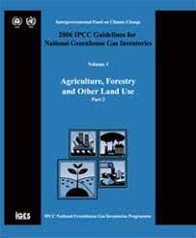
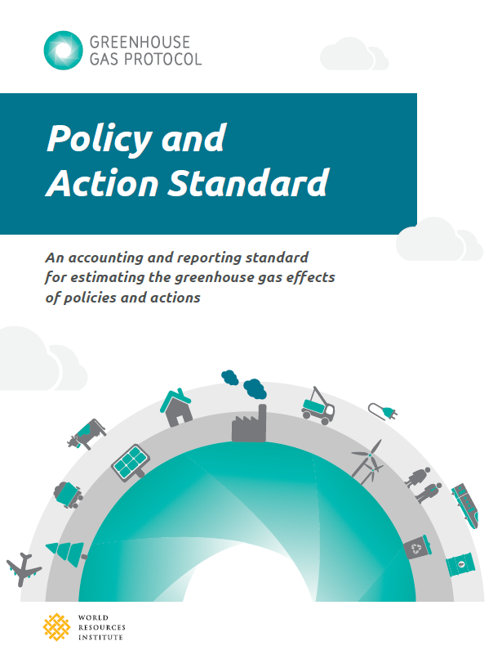
1.2 Relationship to other guidance and resources
This methodology uses and builds on existing resources mentioned throughout the document, including:
Volume 4 of the Intergovernmental Panel on Climate Change (IPCC) 2006 IPCC Guidelines for National Greenhouse Gas Inventories (IPCC 2006 GL) – Agriculture, Forestry and Other Land Use
Greenhouse Gas Protocol Policy and Action Standard (WRI, 2014)
Chapter 1
Chapter 2
Chapter 3
Chapter 4
Notes:
PRESENTATION TEXT: The methodology adapts the structure, and some of the tables, figures and text from the Policy and Action Standard, where relevant.

Slide 8
1.3 Intended users
Government
Policy makers
Practitioners
Chapter 1
Chapter 2
Chapter 3
Chapter 4
Notes:
PRESENTER TEXT: This methodology is intended for use by policymakers and practitioners seeking to estimate GHG mitigation impacts in the context of development and implementation of nationally determined contributions (NDCs), national low-carbon strategies, nationally appropriate mitigation actions (NAMAs) and other mechanisms. The primary intended users are developing country governments and their partners who are implementing and assessing forest policies.
“Which government, policy makers, and practioners in this country might want to assess a forest policy?”

Slide 9
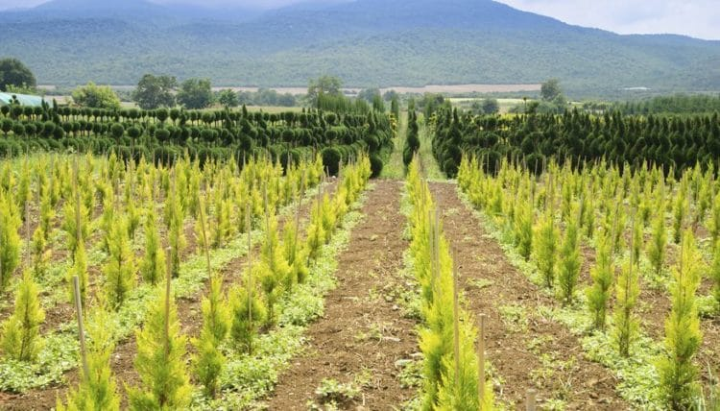
1.4 Scope of the methodology
Principles, concepts and procedures for estimating GHG impacts of forests that increase carbon sequestration and/or reduce GHG emissions from:
Afforestation and/or reforestation (A/R)
Increase carbon sequestration and/or reduce emissions by establishing, increasing or restoring vegetative cover through the planting, sowing or human-assisted natural generation of trees.
Chapter 1
Chapter 2
Chapter 3
Chapter 4
Notes:
PRESENTATION TEXT: This document details a process for users to follow when conducting a GHG assessment of forest policies. It provides guidance on defining the assessment, an approach to GHG assessment including ex-ante (forward-looking) assessments and ex-post (backward-looking) assessments, and monitoring and reporting.
[NOTE: Image from https://www.greenandgrowing.org/what-is-afforestation/]

Slide 10
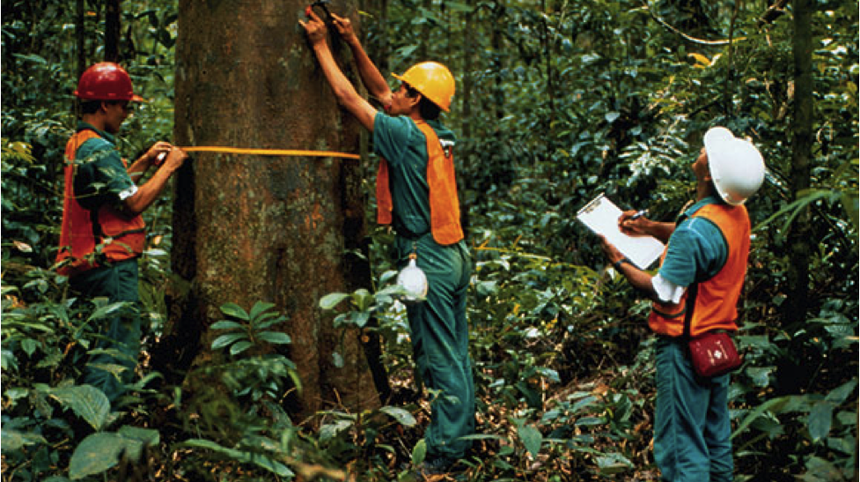
1.4 Scope of the methodology
Principles, concepts and procedures for estimating GHG impacts of forests that increase carbon sequestration and/or reduce GHG emissions from:
Sustainable forest management (SFM)
Increase carbon sequestration and/or reduce emissions on forest lands managed for wood products such as sawtimber, pulpwood and fuelwood by increasing biomass carbon stocks through improving forest management practices
Chapter 1
Chapter 2
Chapter 3
Chapter 4
Notes:
PRESENTATION TEXT: This document details a process for users to follow when conducting a GHG assessment of forest policies. It provides guidance on defining the assessment, an approach to GHG assessment including ex-ante (forward-looking) assessments and ex-post (backward-looking) assessments, and monitoring and reporting.
[NOTE: Image from https://www.decibeldesigns.com/blog/sustainable-forest-management-why-does-it-matter/]

Slide 11
1.4 Scope of the methodology
Principles, concepts and procedures for estimating GHG impacts of forests that increase carbon sequestration and/or reduce GHG emissions from:
Reduce deforestation and/or degradation
Reduce net GHG emissions by reducing conversion of forest lands with high carbon stocks to forest or non-forest lands with lower carbon stocks
Chapter 1
Chapter 2
Chapter 3
Chapter 4
Notes:
PRESENTATION TEXT: This document details a process for users to follow when conducting a GHG assessment of forest policies. It provides guidance on defining the assessment, an approach to GHG assessment including ex-ante (forward-looking) assessments and ex-post (backward-looking) assessments, and monitoring and reporting.
[NOTE: Image from https://www.greenbiz.com/article/reduce-deforestation-we-must-get-serious-about-environmental-crime/]

Slide 12
1.4 Applicability of the methodology
Applies to policies:
At any level of government in all countries and regions.
That are planned, adopted, or implemented.
That are new policies, as well as extensions, modifications, or eliminations of existing policies
Introductory Guide
Chapter 1
Chapter 2
Chapter 3
Chapter 4
Notes:
PRESENTATION TEXT: The guidance is applicable to users that have defined the individual policy instruments and mitigation practices and/or technologies that could be implemented to reduce GHG emissions.
Refer to box 3.1 for examples which one can tailor for describing policies in their country; note that more detail will come at slide 17.
[SLIDE FUNCTIONALITY: Click on the green Introductory Guide button to go to the ICAT introductory guide to learn more.]

Slide 13
1.5 When to use the methodology
Guidance can be applied at any of the stages below or a combination
Define the policy
Assess before policy implementation |  | To assess the expected future impacts of a policy through ex-ante assessment
Implement the policy
Assess during policy implementation | To assess the achieved impacts to date | To assess ongoing performance of key performance indicators | To assess expected future impacts of a policy
Monitor progress
Assess after policy implementation |  | To assess what impacts have occurred as a result of a policy through ex-post assessment
Chapter 1
Chapter 2
Chapter 3
Chapter 4
Notes:
PRESENTATION TEXT: The guidance can be applied before, during or after the policy implementation. The most comprehensive approach is to apply the guidance first before implementation, regularly during policy implementation, and again after implementation.

Slide 14
1.6 Alignment with the enhanced transparency framework of the Paris Agreement
Methodology can help countries to fulfil their accounting and reporting requirements under the enhanced transparency framework of the Paris Agreement.
Alignment of indicators and parameters is recommended for:
Estimating baseline emissions and GHG impacts
Chapter 7 and 8
Projections
Chapter 7
Monitoring and tracking progress towards NDCs
Chapter 11
Monitoring and tracking progress towards SDGs
Chapter 11
Chapter 1
Chapter 2
Chapter 3
Chapter 4
Notes:
PRESENTATION TEXT: The methodology can help countries understand the impacts of forest policies, estimate baseline emissions and GHG impacts, conduct projections, and monitor progress over time using indicators and parameters. This enables countries to account for their contributions and track progress towards implementation and achievement of their NDCs.
Estimating baseline emissions and GHG impacts: Align input parameters for baseline emission and GHG impact of forest policy with input parameters for GHG accounting of NDCs
Projections: Align parameters and time frame for developing projections for forest policies with parameters and time frame for reporting requirements of the transparency framework.
Monitoring and tracking progress towards NDCs: Indicators and parameters to monitor forest policy implementation can also be used to track progress towards implementation and achievement of NDC and SD impacts.
Chapter 7 and 8 are dealt with in Part III, while chapter 11 in Part IV.

Slide 15
Chapter 2. Objectives of assessing GHG impacts of forest policies
Understand the objectives of estimating GHG impacts
Objectives of assessing impacts before policy implementation
(Section 2.1)
Objectives of assessing impacts during or after policy implementation
(Section 2.2)
Notes:
[SLIDE FUNCTIONALITY NOTES: Click on the blue boxes to go directly to the relevant sections.]

Slide 16
2.1 Objectives of assessing GHG impacts
Objectives of assessing impacts before (ex-ante) policy implementation:
Inform policy selection by comparing policy options based on their expected future impacts
Improve policy design and implementation by understanding the impacts of different design and implementation choices
Inform goal setting by assessing the potential contribution of policy options to national goals, such as NDCs and NAMAs
Report on the multiple expected future impacts of policies, domestically and/or internationally
Access financing for policies under consideration by demonstrating expected future results
Users should refer to ICAT Sustainable Development Methodology and Transformational Change Methodology to assess the broader impacts
Determine the objectives of the assessment at the beginning of the impact assessment progress.
Chapter 1
Chapter 2
Chapter 3
Chapter 4
Notes:
PRESENTATION TEXT: Assessing the GHG impacts of policies is a key step towards identifying opportunities and gaps in effective GHG mitigation strategies. Impact assessment supports evidence-based decision-making by enabling policymakers and stakeholders to understand the relationship between policies and expected or achieved GHG impacts. The ICAT Sustainable Development Methodology and Transformational Change Methodology can be used to assess the broader sustainable development and transformational impacts of forest policies, and users should refer to these methodologies for objectives for assessing such impacts.
[SLIDE FUNCTIONALITY NOTE: Click on the blue interactive buttons at the bottom of the slide and they will take you to the webpage where the Sustainable Development and Transformational Change ICAT Guides are found.]

Slide 17
2.2 Objectives of assessing GHG impacts
Objectives of assessing impacts during or after (ex-post) policy implementation:
Assess policy effectiveness
Improve policy implementation
Inform future policy design and decide whether to continue current actions, enhance current actions or implement new actions
Learn from experience and share best practices
Track progress toward national goals (e.g. NDCs and SDGs) and understand the contribution of policies toward achieving them
Report domestically or internationally on the impacts of policies achieved to date
Meet funder requirements to report on impacts of policies
Determine the objectives of the assessment at the beginning of the impact assessment progress.
Chapter 1
Chapter 2
Chapter 3
Chapter 4
Notes:
PRESENTATION TEXT: Learners can refer to the Sustainable Development and Transformational Change Assessment Guides for further information.

Slide 18
Chapter 3. Understand forest policies
Overview of the types of forest policies, and mitigation practices and technologies, to which this guidance can be applied.
Forestry policy instrument
(Section 3.1)
Mitigation practices or technologies
(Section 3.2)
Notes:
PRESENTATION TEXT: This chapter provides an overview of the types of forest policy instruments, and mitigation practices and technologies, to which this methodology can be applied. This methodology is primarily designed to assess specific policy instruments and associated mitigation practices and/or technologies in the forestry sector. In this document, policies are instruments that enable or incentivize the implementation of GHG mitigation measures. Measures are the practices and technologies that reduce emissions.
[SLIDE FUNCTIONALITY NOTES: Click on the blue boxes to go directly to the relevant sections.]

Slide 19
3.1 Forest policy instruments
Regulations and standards
Subsidies and incentives
Voluntary agreements or actions
Information instruments
Trading programmes
Research, development and deployment policies
Financing and investment
Chapter 1
Chapter 2
Chapter 3
Chapter 4
Notes:
PRESENTATION TEXT:
Regulations and standards: Rules or standards that specify abatement technologies (technology standard) or performance standards (such as minimum requirements for erosion rates, tillage setbacks or nutrient management. They typically include legal penalties for noncompliance.
Subsidies and incentives: Direct payments, tax reductions, price supports or the equivalent thereof from a government to an entity for implementing a practice or performing a specified action.
Voluntary agreements or actions: Agreements, commitments or actions undertaken voluntarily by public or private sector actors, either unilaterally or jointly in a negotiated agreement. Some voluntary agreements include rewards or penalties associated with participating in the agreement or achieving the commitments.
Information instructions: Requirements for public disclosure of information. These include labelling programmes, emissions reporting programmes, rating and certification systems, benchmarking, and information or education campaigns aimed at changing behaviour by increasing awareness.
Trading programmes: Programmes that establish a limit on aggregate emissions or pollutants from specified sources, requires sources to hold permits, allowances, or other units equal to their actual emissions or pollution, and allows permits to be traded among sources.
Research, development and deployment policies: Policies aimed at supporting technological advancement, through direct government funding or investment, or facilitation of investment, in technology research, development, demonstration, and deployment activities.
Financing and investment: Public or private sector grants or loans (for example, those supporting low-carbon development strategies or policies)

Slide 20
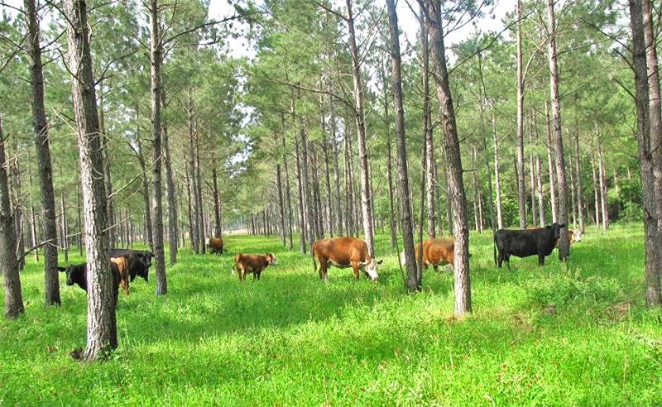
3.2 Common mitigation practices or technologies
Mitigation practices that reduce emissions or enhance removals through A/R
Planting trees/woody biomass (including agroforestry and silvopasture)
Removing vegetation that competes with trees
Making sites suitable for natural regeneration
Removing ongoing disturbances that prevent reforestation or natural regeneration
Chapter 1
Chapter 2
Chapter 3
Chapter 4
Notes:
PRESENTATION TEXT:
[COUNTRY SPECIFIC SLIDE ADAPTATION NOTE: Country specific examples can be added to the list by the presenter.]

Slide 21
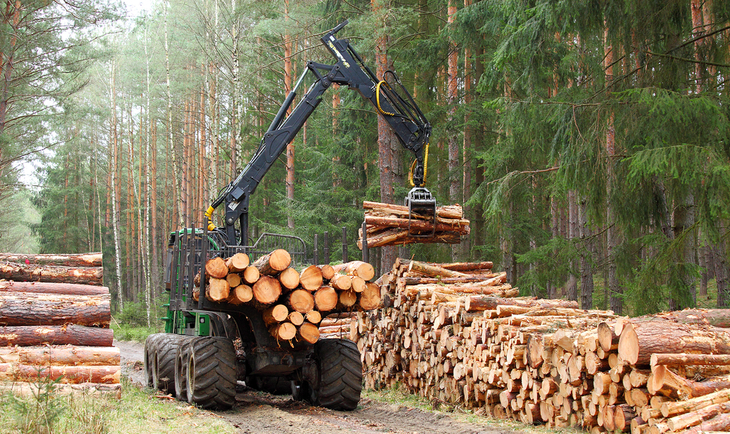
3.2 Common mitigation practices or technologies
Mitigation practices that reduce emissions or enhance removals through SFM
Improving forest management practices
Enhancing productivity
Improving harvest efficiency
Improving mill efficiency and utilization of wood products
Chapter 1
Chapter 2
Chapter 3
Chapter 4
Notes:
PRESENTATION TEXT:
Improving forest management practices
e.g., increasing the minimum age or the minimum diameter of cutting thresholds, extending the re-entry period for selective harvesting, improving the selection of trees for harvesting, implementing sustainable harvest modelling, implementing stocking retention requirements
Enhancing productivity
e.g., supplemental planting and thinning, introducing tree species with higher growing rates
Improving harvest efficiency
e.g., reducing damage or felling of other trees, reducing the size of logging roads
Improving mill efficiency and utilization of wood products
[COUNTRY SPECIFIC SLIDE ADAPTATION NOTE: Country specific examples can be added to the list by the presenter.]

Slide 22
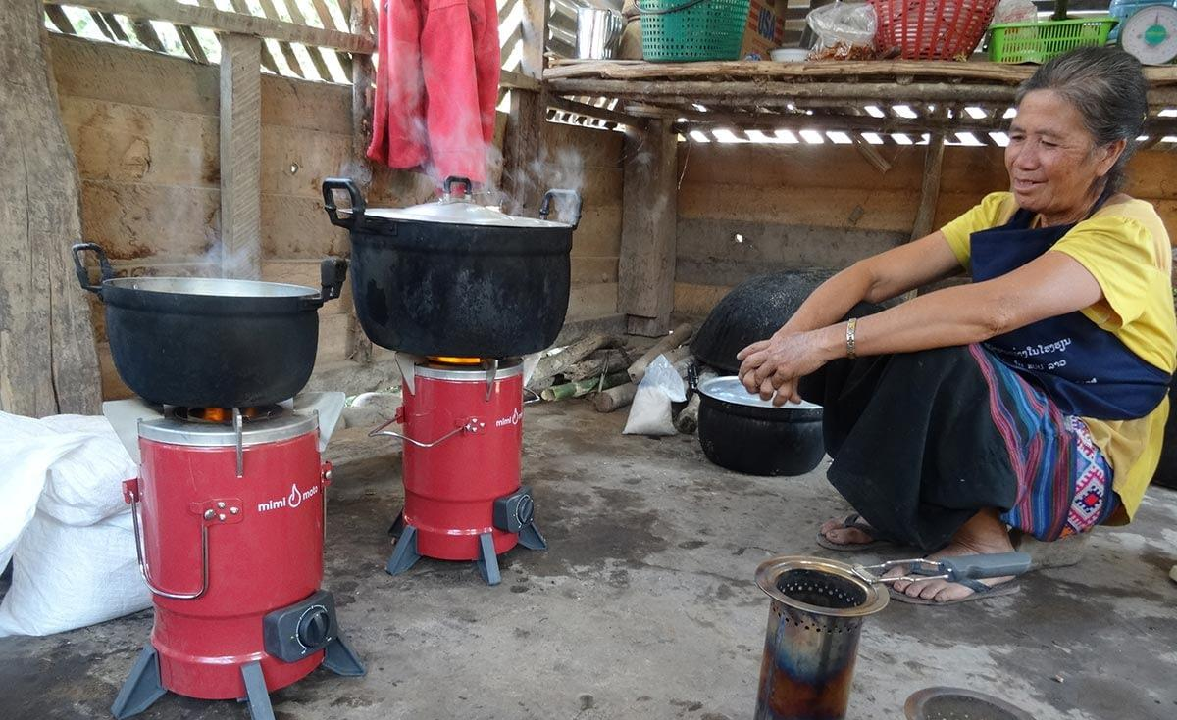
3.2 Common mitigation practices or technologies
Mitigation practices that reduce emissions through deforestation/degradation
Conserving forests on public or private land
Providing alternative sources for fuelwood
Converting logged forests to protected forests
Increasing sustainable agricultural intensification to reduce conversion of forest lands
Chapter 1
Chapter 2
Chapter 3
Chapter 4
Notes:
PRESENTATION TEXT: alternative sources for fuelwood - e.g., woodlots for fuel, gas or kerosene for cooking
[COUNTRY SPECIFIC SLIDE ADAPTATION NOTE: Country specific examples can be added to the list by the presenter.]

Slide 23
Chapter 4. Using the methodology
Overview of the underlying concepts, methodological steps and planning needed for assessing the impacts of forest policies.
Overview of steps
(Section 4.1)
Planning for the assessment
(Section 4.2)
Assessment principles
(Section 4.3)
Notes:
[SLIDE FUNCTIONALITY NOTES: Click on the blue boxes to go directly to the relevant sections.]

Slide 24
4.1 Overview of the steps
The guidance is organised according to the steps a user follows in assessing the GHG impacts of a policy
Depending on when the guidance is applied and the approach chosen, users can skip certain chapters.
Overview of steps
Chapter 1
Chapter 2
Chapter 3
Chapter 4
Notes:
PRESENTATION TEXT: The overview steps are those which were seen in slide 3.
[SLIDE FUNCTIONALITY NOTE: Click on the “Overview of steps” button to review the steps.]

Slide 25
4.2 Planning for the assessment
Choose a desired level of accuracy based on objective
(Section 4.2.1)
Select an approach for assessing the GHG impacts of forest policies (Section 4.2.2)
Select a methodology for obtaining or estimating data
(Section 4.2.3)
Expert judgement
(Section 4.2.4)
Plan for stakeholder participation
(Section 4.2.5)
Plan for technical review (if relevant)
(Section 4.2.6)
Chapter 1
Chapter 2
Chapter 3
Chapter 4
Notes:
[SLIDE FUNCTIONALITY: The presenter can click on each section to go directly to that section. In addition, clicking on the Stakeholder Participation and Technical review will take you to the relevant webpage to show the guidance.]

Slide 26
4.2.1 Choosing a desired level of accuracy
The objectives of the assessment will determine the level of accuracy required
Broad objectives
(e.g., to assess if a policy contributes to reduced GHG impacts)
Specific objectives
(e.g., a particular reduction occurs due to a specific policy)
LOW
HIGH
ACCURACY
The accuracy will determine the amount of data, time and resources required for the assessment
Data
Time
Resources
User need to manage trade-offs between the accuracy of the results and the data, time and resources required
Chapter 1
Chapter 2
Chapter 3
Chapter 4
Notes:
PRESENTATION TEXT: There are a range of options for assessing GHG impacts that allow users to manage trade-offs between the accuracy of the results and the resources, time, and data needed to complete the assessment, based on objectives.
Users should choose approaches and methods that are sufficient to accurately meet the stated objectives of the assessment and ensure that the resulting claims are appropriate.

Slide 27
4.2.2 Approaches for assessing the GHG impacts
EMISSIONS APPROACH
ACTIVITY DATA APPROACH
Compares the difference in GHG emissions and removals between the policy and baseline scenarios
Difference between policy and baseline scenario is the impact resulting from the policy
Focuses on estimating the effect of the policy on activity data by estimating the expected increase or decrease in the area of land or in the adoption of a mitigation practice that is triggered by the policy
Chapter 1
Chapter 2
Chapter 3
Chapter 4
Notes:
PRESENTATION TEXT:
Emissions approach: In this method, users determine the most likely baseline scenario for land use, land-use change and/or timber management practices, and estimate baseline emissions and removals (Chapter 7). Users then develop the most likely policy scenario by determining the likely implementation potential of the policy (Sections 8.2–8.5). Policy scenario emissions and removals are quantified by using the same method that was used to estimate the baseline emissions and removals, with parameter values that are adjusted for the policy scenario. The net change in GHG emissions and removals is the difference between policy and baseline emissions and removals.
Activity data approach: In this approach, users estimate the maximum implementation potential of the policy (following the approach in Chapter 8), based on the causal chain that is developed in Chapter 6. The maximum implementation potential is estimated in terms of activity data. “Activity data” are parameters that are expected to change in value as a result of the policy. This approach is best for policies that target changes in activity data (e.g. hectares [ha] of forest land remaining as forest land). Estimating baseline emissions is optional when using this approach; the GHG impacts of the policy can be calculated directly, without explicitly determining separate baseline and policy scenarios. In such cases, users can skip Chapter 7.

Slide 28
4.2.2 Approaches for assessing the GHG impacts
Approach | Advantages | Disadvantages
Emissions approach | Enables more robust and accurate understanding of the GHG impacts of forest policies Meets wider set of objectives (related to understanding policy impact) Meets widest set of stakeholder needs | Increased time, cost, data and capacity needs, depending on approach taken (simpler to more complex)
Activity data approach | Gives an understanding of expected GHG impacts Easier, simpler, requires less time, resources and capacity | Provides a more informative estimate of the GHG impacts of the policy, which limits the range of objectives the assessment can meet Risk of over-simplification or limited understanding of relevant impact drivers
Choosing an approach
Chapter 1
Chapter 2
Chapter 3
Chapter 4
Notes:
[SLIDE FUNCTIONALITY NOTE: Click on the yellow interactive button to see more detail on choosing an approach.]

Slide 29
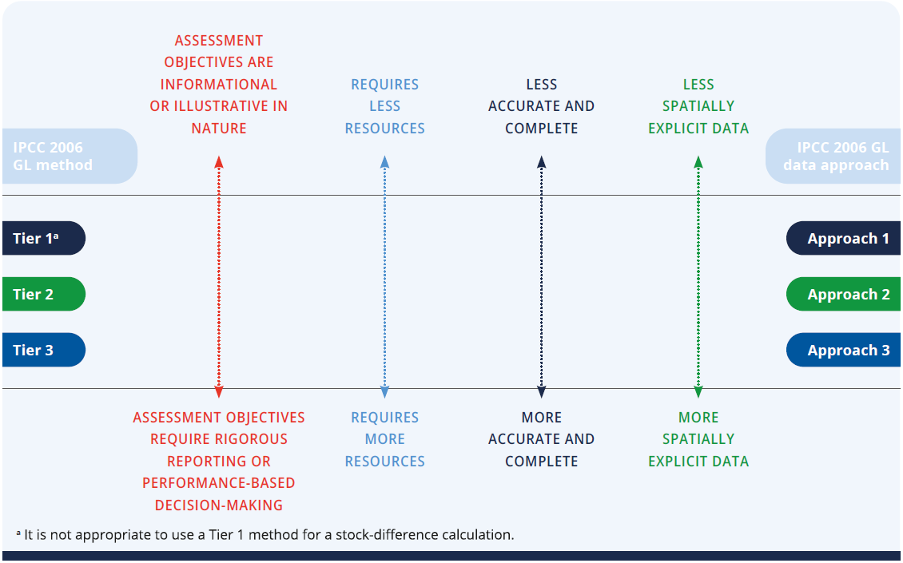
4.2.3 Methods for obtaining or estimating data
Methodology provides simplified (Tier 1) methods for estimating spatial data and carbon stock change; it does not describe higher Tier methods.
Chapter 1
Chapter 2
Chapter 3
Chapter 4
Notes:
PRESENTATION TEXT: Users may decide on their method of assessment based on both their assessment objectives and their capacity, resources and time available to carry out the assessment (Figure 4.1). For planning purposes, it is helpful for users to identify the desired estimation method before beginning an impact assessment. Users may rely on a combination of methods within a policy estimation. For example, if a policy affects multiple carbon pools, each carbon pool estimate could use a different methodological tier. Similarly, data availability may vary across policy locations, requiring the use of different approaches. Users using a combination of methods and approaches should heed the consistency and comparability assessment principles described in the next section.

Slide 30
4.2.4 Expert judgement
Expert judgement is likely to be needed in order to complete an assessment where information is not available or requires interpretation.
IPCC 2006 GL provides procedures for expert elicitation which avoid biases and produce independent and reliable judgements.
Expert judgement can be informed through broader stakeholder consultation.
EXPERT JUDGEMENT (IPCC)
Carefully considered, well-documented qualitative or quantitative judgement made in the absence of unequivocal observational evidence by a person or persons who have a demonstrable expertise in the given field.
IPCC
Chapter 1
Chapter 2
Chapter 3
Chapter 4
Notes:
PRESENTATION TEXT: Expert judgment can be associated with a high level of uncertainty. As such, experts can be consulted to provide a range of possible values and the related uncertainty range, or to help select suitable values from a range of values. Expert judgment can be informed or supported by broader consultations with stakeholders. It is important to document the reason that no data sources are available and the rationale for the value chosen.
[SLIDE FUNCTIONALITY NOTE: Click on the interactive blue buttons at the bottom of the page to go to the webpage for IPCC and for ICAT Stakeholder Participation Guide.]

Slide 31
4.2.5 Planning stakeholder participation
Stakeholder participation is recommended in many steps throughout the guidance.
Strengthens the impact assessment and the contribution of policies to GHG mitigation goals in many way
Helps reduce negative impacts and enhance benefits for all stakeholder groups
Builds trust | Creates a mechanism for raising issues before implementation
Raises awareness | Enhances credibility
Enhances transparency | Enhances ambition and finance
Chapter 1
Chapter 2
Chapter 3
Chapter 4
Notes:
PRESENTATION TEXT: Before beginning the assessment process, users should consider how stakeholder participation can support the objectives, and include relevant activities and associated resources in assessment plans. It is important to conform with national legal requirements and norms for stakeholder participation in public policies. During the planning phase, it is recommended that users identify stakeholder groups that may be affected by, or may influence, the policy. Appropriate approaches should be identified to engage with stakeholder groups, including through their legitimate representatives. Effective stakeholder participation could be facilitated by establishing a multi-stakeholder working group or advisory body consisting of stakeholders and experts with relevant and diverse knowledge and experience.
[SLIDE FUNCTIONALITY NOTE: Click on the Stakeholder Participation button in the interactive panel to go to the ICAT website where the Guide can be found.]

Slide 32
4.2.6 Planning technical review
Before beginning the assessment process, consider whether technical review of the assessment report will be pursued.
The technical review process emphasises learning and continual improvement and can help identify areas for improving future impact assessments.
Technical review can also provide confidence that the impacts of policies have been estimated and reported according to ICAT key recommendations.
Chapter 1
Chapter 2
Chapter 3
Chapter 4
Notes:
PRESENTATION TEXT: Access the Technical Review Guide to obtain guidance for planning and conducting technical reviews.
[SLIDE FUNCTIONALITY NOTE: Click on the Technical Review interactive button to go to the ICAT webpage where the Guide can be found.]

Slide 33
4.3 Assessment principles
Principles underpin and guide the impact assessment process
RELEVANCE
COMPLETENESS
CONSISTENCY
TRANSPARENCY
ACCURACY
COMPARABILITY
Users should balance trade-offs between principles depending on their assessment objectives.
Over time, as the accuracy and completeness of data increases, the trade-off between these principles will likely diminish.
Base the assessment on the principles of relevance, completeness, consistency, transparency and accuracy.
Conservativeness
Comparability
Chapter 1
Chapter 2
Chapter 3
Chapter 4
Notes:
PRESENTATION TEXT:
Relevance: Ensure the assessment appropriately reflects the GHG impacts of the policy and serves the decision-making needs of users and stakeholders, both internal and external to the reporting entity. Applying the principle of relevance depends on the objectives of the assessment, broader policy objectives, national circumstances and stakeholder priorities.
Completeness: Include all significant impacts in the GHG assessment boundary, including both positive and negative impacts. Disclose and justify any specific exclusions.
Consistency: Use consistent assessment approaches, data collection methods and calculation methods to allow for meaningful performance tracking over time. Document any changes to the data sources, GHG assessment boundary, methods, or any other relevant factors in the time series.
Transparency: Provide clear and complete information for stakeholders to assess the credibility and reliability of the results. Disclose and document all relevant methods, data sources, calculations, assumptions and uncertainties. Disclose the processes, procedures and limitations of the assessment in a clear, factual, neutral, and understandable manner with clear documentation. The information should be sufficient to enable a party external to the assessment process to derive the same results if provided with the same source data. Chapter 11 provides a list of recommended information to report to ensure transparency.
Accuracy: Ensure that the estimated impacts are systematically neither over nor under actual values, as far as can be judged, and that uncertainties are reduced as far as practicable. Achieve sufficient accuracy to enable users and stakeholders to make appropriate and informed decisions with reasonable confidence as to the integrity of the reported information. If accurate data for a given impact category is not currently available, users should strive to improve accuracy over time as better data becomes available. Accuracy should be pursued as far as possible, but once uncertainty can no longer be practically reduced, conservative estimates should be used.
Comparability: Ensure common methods, data sources, assumptions and reporting formats, such as that the estimated impacts of multiple policies can be compared.
[SLIDE FUNCTIONALITY NOTE: Click on the interactive yellow buttons to find more detail on conservativeness and comparability.]

Slide 34
Part I: QUIZ 1
When is the Forest Methodology used?
Answers:
Before policy implementation
During policy implementation
After policy implementation
All of the above
Answer
Notes:
[SLIDE FUNCTIONALITY NOTE: Click on the “Answer” button to reveal the answer.]
[COUNTRY SPECIFIC SLIDE ADAPTATION NOTE: The quiz can be removed if preferred, or the questions could be altered or added to. Further, the quiz questions could be put into Mentimeter to make it more interactive for the audience]

Slide 35
Part I: QUIZ 2
The Forest Methodology provides an overarching framework for estimating GHG impacts of policies that increase carbon sequestration and reduce GHG emissions from which activities?
Answers:
Deforestation
Afforestation
Degradation
Sustainable forest management
All of the above
Answer
Notes:
[SLIDE FUNCTIONALITY NOTE: Click on the “Answer” button to reveal the answer.]
[COUNTRY SPECIFIC SLIDE ADAPTATION NOTE: The quiz can be removed if preferred, or the questions could be altered or added to. Further, the quiz questions could be put into Mentimeter to make it more interactive for the audience]

Slide 36
Part I: QUIZ 3
What does ex-ante mean?
Answers:
Before policy implementation
During policy implementation
After policy implementation
All of the above
Answer
Notes:
[SLIDE FUNCTIONALITY NOTE: Click on the “Answer” button to reveal the answer.]
[COUNTRY SPECIFIC SLIDE ADAPTATION NOTE: The quiz can be removed if preferred, or the questions could be altered or added to. Further, the quiz questions could be put into Mentimeter to make it more interactive for the audience]

Slide 37
Part I: QUIZ 4
What is the approach for assessing GHG impacts called if the difference in GHG emissions and removals due to the policy are compared to the baseline scenarios?
Answers:
Activity data approach
Emissions approach
Tier 1 approach
Tier 2 approach
Answer
Notes:
[SLIDE FUNCTIONALITY NOTE: Click on the “Answer” button to reveal the answer.]
[COUNTRY SPECIFIC SLIDE ADAPTATION NOTE: The quiz can be removed if preferred, or the questions could be altered or added to. Further, the quiz questions could be put into Mentimeter to make it more interactive for the audience]

Slide 38
Part I: QUIZ 5
The Forest Methodology provides details on the use of which approaches?
Answers:
Tier 1
Tier 2
Tier 3
Tier 1 and 2
Tier 1, 2 and 3
Answer
Notes:
[SLIDE FUNCTIONALITY NOTE: Click on the “Answer” button to reveal the answer.]
[COUNTRY SPECIFIC SLIDE ADAPTATION NOTE: The quiz can be removed if preferred, or the questions could be altered or added to. Further, the quiz questions could be put into Mentimeter to make it more interactive for the audience]

Slide 39
Thank you!
www.climateactiontransparency.org
icat@unops.org
Twitter: @ICATclimate
Notes:
[COUNTRY SPECIFIC SLIDE ADAPTATION NOTE: Add the presenters contact details and any other relevant contacts]

Slide 40
Checklist of key recommendations
Chapter | Key recommendation | Check
Chapter 2. Determine the objectives of the assessment | Determine the objectives of the assessment at the beginning of the impact assessment process.
Chapter 4. Using the methodology | Base the assessment on the principles of relevance, completeness, consistency, transparency and accuracy.

Slide 41
3.1 Examples of forest policy instruments
Regulations and standards
Examples:
Standards for timber management practices
Standards for implementing agroforestry or silvopastoral systems
Conservation mandate requiring landowners to reforest an area equivalent to 10% of cultivated lands into conservation reserve
Laws that promote connectivity between natural ecosystems
Moratorium on new land concessions
Moratorium on exporting forest risk commodities from deforestation risk regions (e.g. Brazil municipality black list)
New systems to effectively enforce existing or new environmental regulation (e.g. improve coordination of observation, enforcement and prosecution agencies against illegal logging and land grabbing)
To forestry policy list
Notes:
[COUNTRY SPECIFIC SLIDE ADAPTATION NOTE: Country specific examples can be added to the list by the presenter.]

Slide 42
3.1 Examples of forest policy instruments
Subsidies and incentives
Description:
Direct payments, tax reductions, price supports or the equivalent thereof from a government to an entity for implementing a practice or performing a specified action
Examples:
Payments for setting aside agricultural land
Payments for ecosystem services
To forestry policy list
Notes:
[COUNTRY SPECIFIC SLIDE ADAPTATION NOTE: Country specific examples can be added to the list by the presenter.]

Slide 43
3.1 Examples of forest policy instruments
Voluntary agreements or actions
Description:
Agreements, commitments or actions undertaken voluntarily by public or private sector actors, either unilaterally or jointly in a negotiated agreement. Some voluntary agreements include rewards or penalties associated with participating in the agreement or achieving the commitments
Examples:
Zero net-deforestation commitments
Ecosystem restoration commitments (e.g. Bonn Challenge)
Agroforestry agreements with landowner
National programmes to reduce emissions in a sector (e.g. NAMA)
Low-carbon development projects
To forestry policy list
Notes:
[COUNTRY SPECIFIC SLIDE ADAPTATION NOTE: Country specific examples can be added to the list by the presenter.]

Slide 44
3.1 Examples of forest policy instruments
Information instruments
Description:
Requirements for public disclosure of information. These include labelling programmes, emissions reporting programmes, rating and certification systems, benchmarking, and information or education campaigns aimed at changing behaviour by increasing awareness.
Examples:
Programmes requiring standardized labelling on environmental attributes of agricultural and forest products by increasing awareness
To forestry policy list
Notes:
[COUNTRY SPECIFIC SLIDE ADAPTATION NOTE: Country specific examples can be added to the list by the presenter.]

Slide 45
3.1 Examples of forest policy instruments
Trading programmes
Description:
Programmes that establish a limit on aggregate emissions or pollutants from specified sources; require sources to hold permits, allowances or other units equal to their actual emissions or pollution; and allow permits to be traded among sources
Examples:
Nutrient trading programmes
Cap-and-trade programmes
To forestry policy list
Notes:
[COUNTRY SPECIFIC SLIDE ADAPTATION NOTE: Country specific examples can be added to the list by the presenter.]

Slide 46
3.1 Examples of forest policy instruments
Research, development & deployment policies
Description:
Policies aimed at supporting technological advancement, through direct government funding or investment, or facilitation of investment, in technology research, development, demonstration, and deployment activities
Examples:
Efforts to strengthen formal education of farmers, provide training and introduce new technologies or practices to farmers, provided by extension services or programmes supported by the government
Training modules about sustainable production and climate change disseminated through extension agents
Regional workshops to agricultural producers
To forestry policy list
Notes:
[COUNTRY SPECIFIC SLIDE ADAPTATION NOTE: Country specific examples can be added to the list by the presenter.]

Slide 47
3.1 Examples of forest policy instruments
Financing and investment
Description:
Public or private sector grants or loans (for example, those supporting low-carbon development strategies or policies)
Examples:
Low-interest rate loans for forest land managers who implement sustainable timber management practices
To forestry policy list
Notes:
[COUNTRY SPECIFIC SLIDE ADAPTATION NOTE: Country specific examples can be added to the list by the presenter.]

Slide 48
Overview of the Forest Methodology
Part 1
Introduction, objectives, key steps and overview of forest policies
Understand purpose and applicability of the methodology (Chapter 1)
Determine the objectives of estimating GHG impacts (Chapter 2)
Understand forest policies (Chapter 3)
Understand how to use the methodology guidance (Chapter 4)
Part 2
Defining the assessment
Clearly describe the policy to be assessed (Chapter 5)
Identify the GHG impacts (Chapter 6)
Part 3
Assessing impacts
Estimate the baseline scenario and emissions (Chapter 7)
Estimate the GHG impacts of the policy ex-ante (Chapter 8)
Estimate the GHG impacts of the policy ex-post (Chapter 9)
Part 4
Monitoring and reporting
Understand how to monitor performance of the policy over time (Chapter 10)
Understand how to report (Chapter 11)
Previous slide

Slide 49
4.2.2 Choosing an approach based on objectives
If the objective is to understand the impact of a policy and use that information to meet other objectives – such as informing policy design, improving policy implementation, evaluating policy effectiveness, reporting on policy impacts, and attracting finance based on policy impacts – the user should use a more robust approach for assessing impacts, and obtaining and estimating data.
Some objectives may be achieved with an activity data approach, such as gaining an understanding of impacts in a short time to guide decision-making.
Other objectives may require a more rigorous emissions approach, such as attracting public or private financing to implement an intervention and achieve specific results.
Generally, the emissions approach requires more time and resources, whereas the activity data approach is less resource-intensive but may not fully meet all of a user’s objectives.
Previous slide

Slide 50
Conservativeness
Conservative values and assumptions are more likely to overestimate negative impacts or underestimate positive impacts resulting from a policy.
Users should consider conservativeness in addition to accuracy when uncertainty can no longer be practically reduced, when a range of possible values or probabilities exists (e.g., when developing baseline scenarios), or when uncertainty is high.
Whether to use conservative estimates and how conservative to be depends on the objectives and the intended use of the results.
For some objectives, accuracy should be prioritized over conservativeness, to obtain unbiased results.
The principle of relevance can help guide what approach to use and how conservative to be.
Previous slide

Slide 51
Principle of comparability
Users may want to compare the estimated impacts of multiple policies.
Valid comparisons require that assessments have followed a consistent methodology – for example, regarding the assessment period, the types of impact categories, impacts, and indicators included in the GHG assessment boundary; baseline assumptions; calculation methods; and data sources.
Users should exercise caution when comparing the results of multiple assessments, since differences in reported impacts may be a result of differences in methodology rather than real-world differences. To understand whether comparisons are valid, all methods, assumptions and data sources used should be transparently reported.
Comparability can be more easily achieved if a single person or organization assesses and compares multiple policies using the same methodology.
Users may also want to aggregate the impacts of multiple policies.
Users should likewise exercise caution when aggregating the results if different methods have been used and if there are potential overlaps or interactions between the policies being aggregated.
In such a case, the sum would either overestimate or underestimate the impacts resulting from the combination of policies. For example, the combined impact of a local energy efficiency policy and a national energy efficiency policy in the same country will probably be less than the sum of the impacts had they been implemented separately, since they affect the same activities.
Previous slide

